Slide 1


The Complete
SQL Masterclass
For Data Analytics

Slide 2
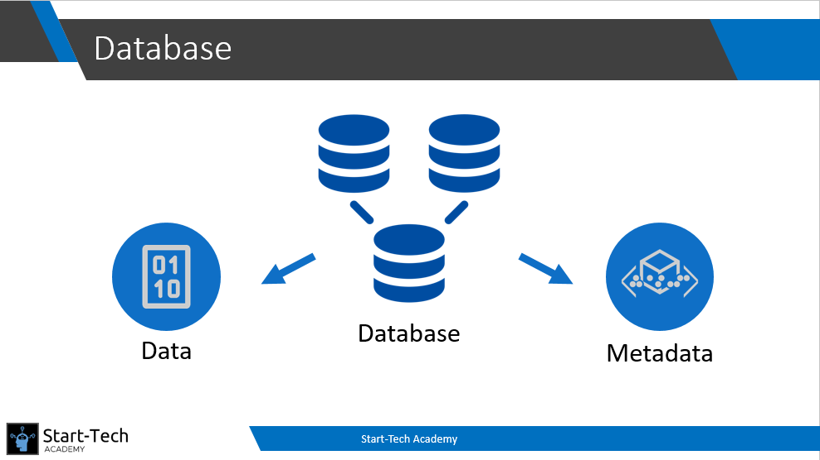
Basics of Data Management
SQL Basics
Database Basics
SQL Queries

Slide 3


Fundamental SQL Commands
Create
Select
Insert, Copy
Update, Alter

Slide 4
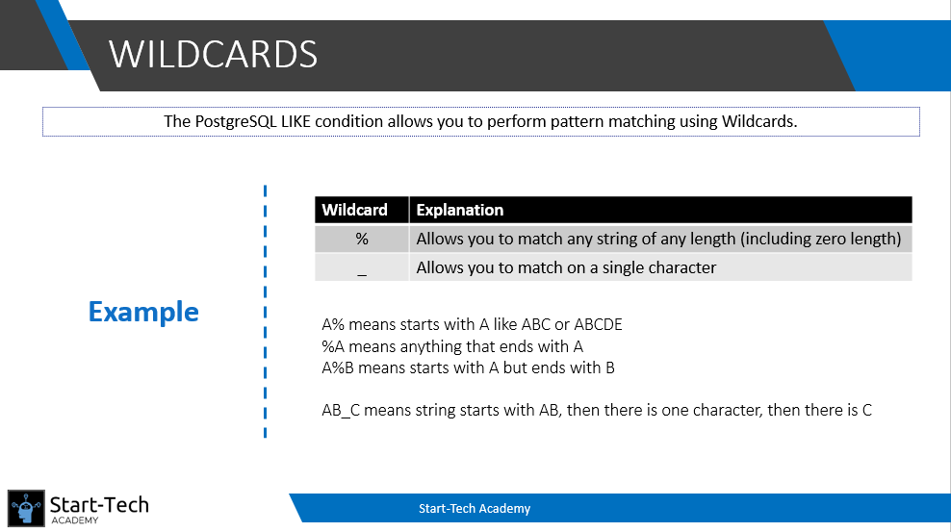
Data Filtering and Sorting
Where command
Order By
Or, And, Not
In, Between, Like

Slide 5
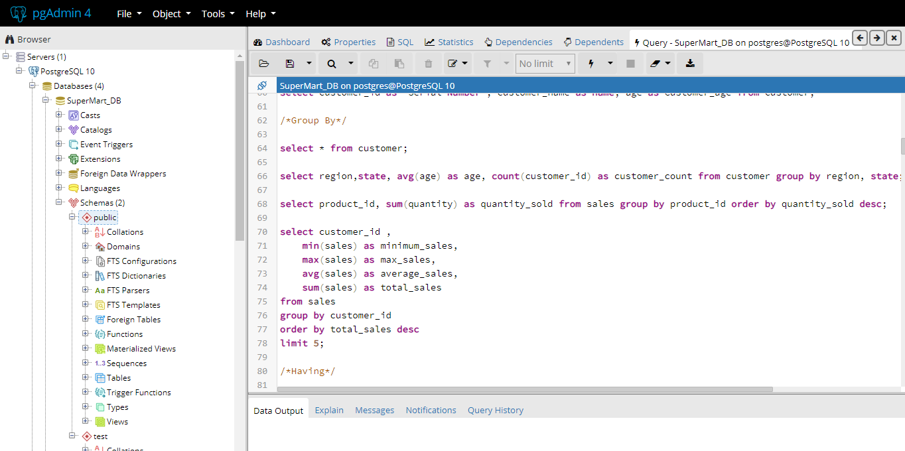
Aggregate and Group By commands
Sum, Average
Count, Min, Max
Group By
Having

Slide 6
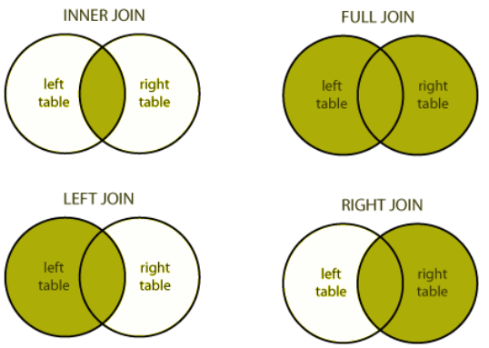
Joins
Inner/Outer join
Left/Right Join
Cross Join
Except & Union

Slide 7
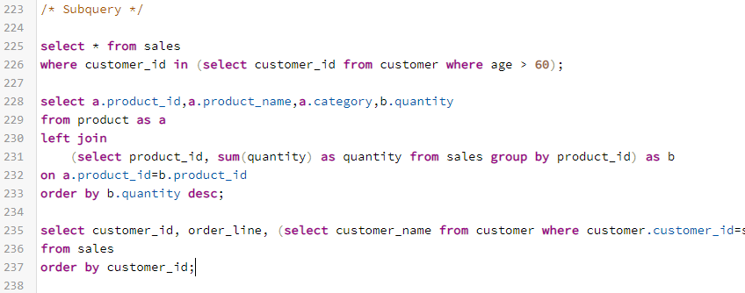
Advanced Concepts
Subqueries
Views
Indexes

Slide 8
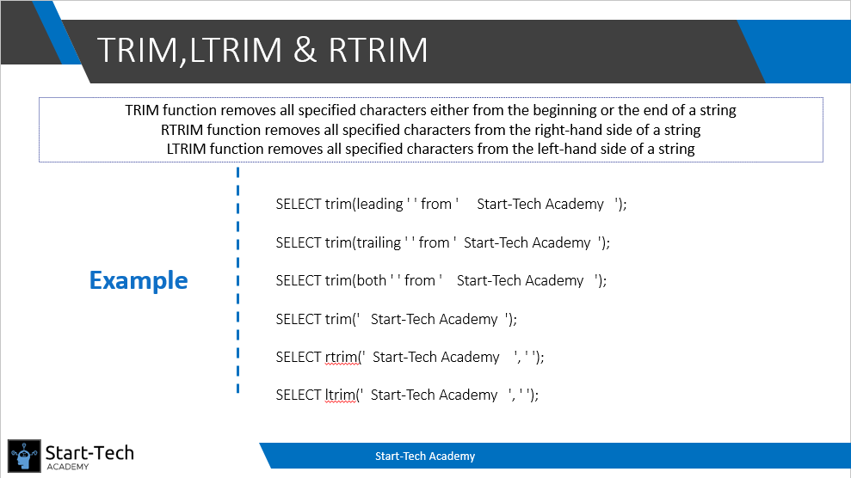
String Functions
Upper Lower
TRIM,LTRIM, RTRIM
Replace, Substring
Concat, String Agg

Slide 9
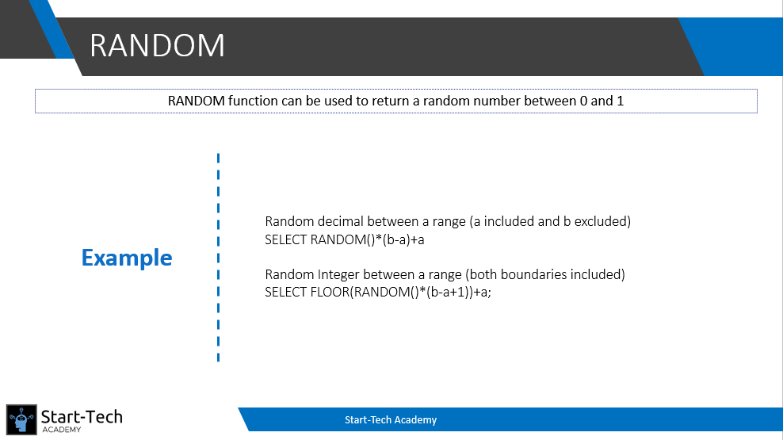
Mathematical Functions
CEIL & FLOOR
Random, Setseed
Round
Power

Slide 10
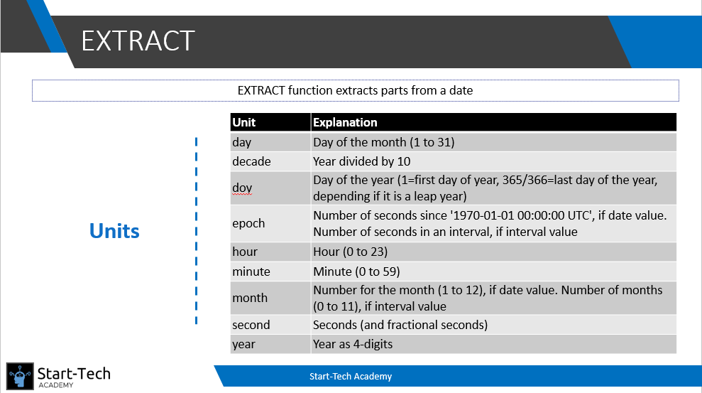
Date Time Function
Current Date
Current Time
Age
Extract

Slide 11
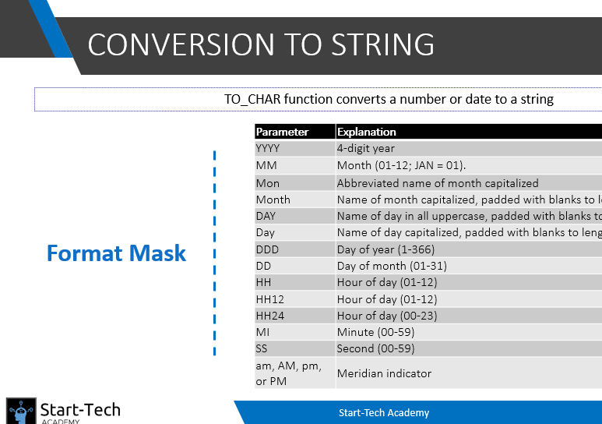
Data Type Conversion Functions
Conversion to String
Conversion to Date
Conversion to Number

Slide 12
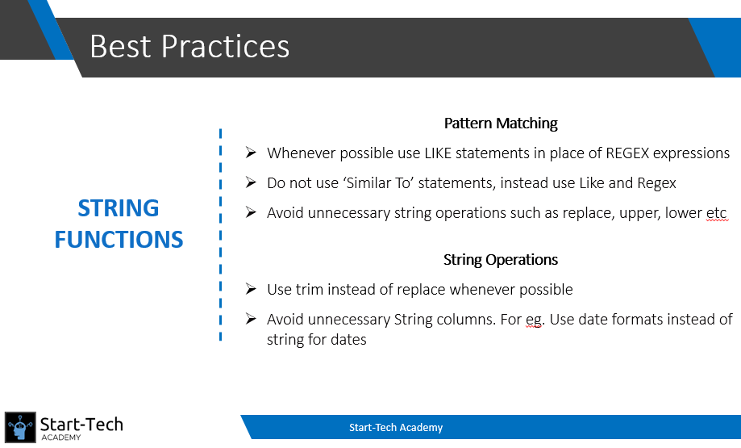
Performance Tuning
Explain
Tips for String
Tips for Joins
Query Comparison

Slide 13
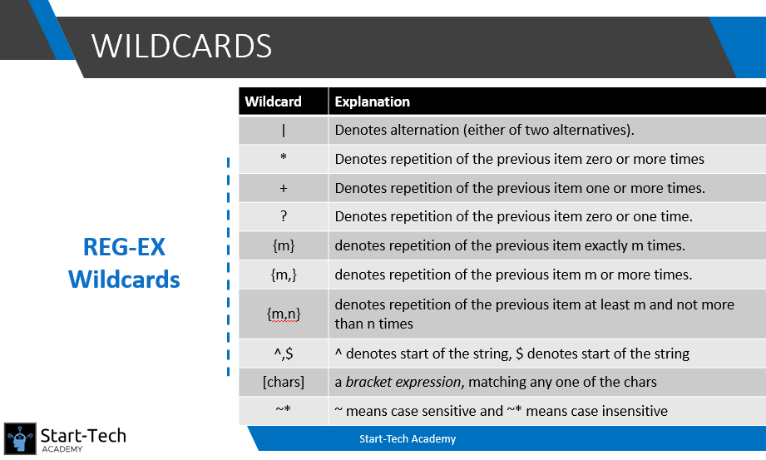
Pattern Matching
Like
Similar to
~ (Regular Expressions)

Slide 14


Bonus lectures
Interview tips
Keys
Access Control
Tablespace

